Slide 1
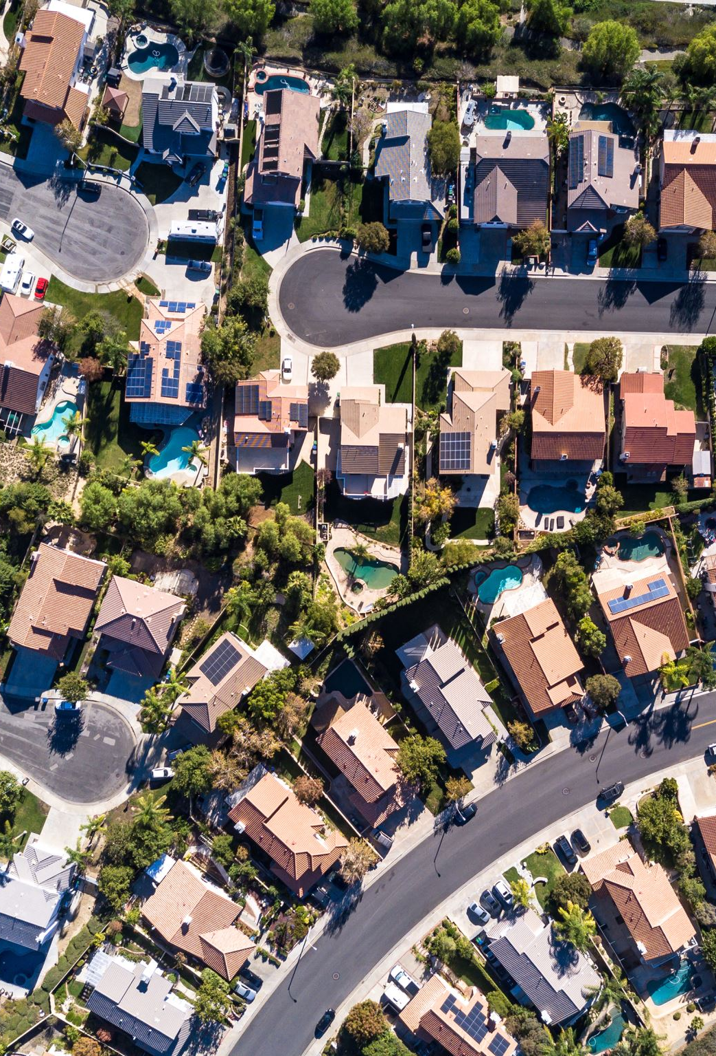
Analyzing Long-Term Residential Investment Potential in Montgomery County, Maryland
By: Charanpreet Singh
Capstone DATA 205 Professor Perine

Slide 2
Introduction/Overview
Which Montgomery County cities show the strongest indicators for long-term residential real estate investment?
Project Overview
Analyze long-term housing price trends
Compare appreciation and volatility
Integrate Census demographic data
Build investment-focused metrics
Why It Matters
Housing affordability
Investment decision-making
Population and income trends

Slide 3
Data Sources
Zillow ZHVI Data: https://www.zillow.com/research/data/
Monthly housing values
City level housing trends
Historical housing appreciation
Census Data calling API: https://www.census.gov/data.html
Population
Median household income
Median rent
Median home value

Slide 4

Tools & Methods
Tools
R
tidyverse
ggplot2
tidycensus
Methods
Data cleaning
Time-series analysis
Volatility calculations
Data joins
Affordability analysis

Slide 5
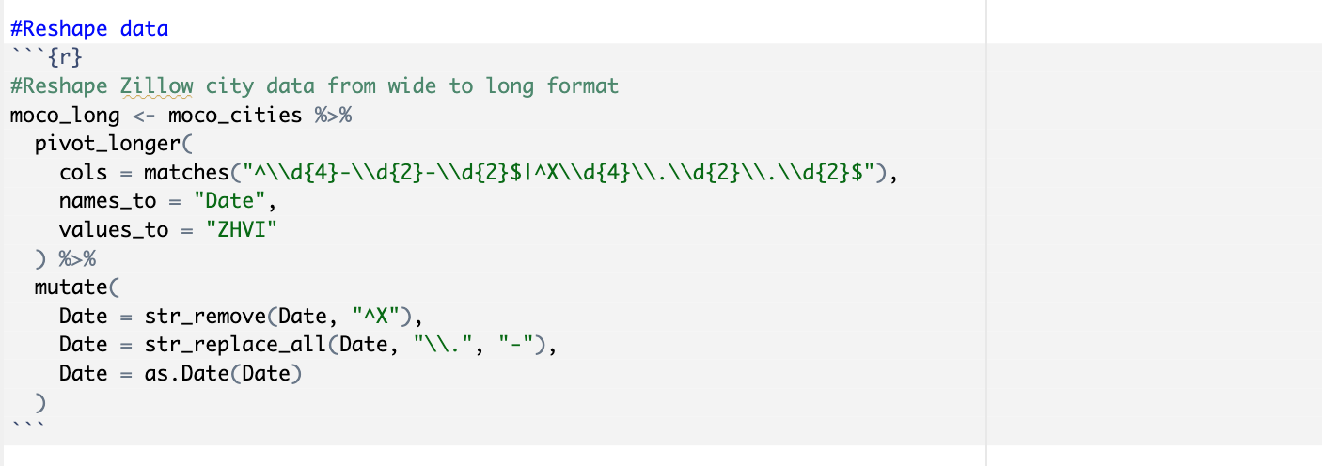
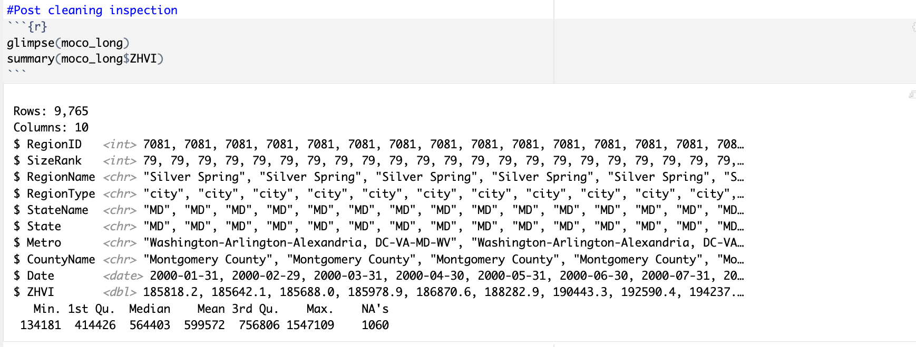
Data Cleaning & Pre Processing
Key Steps
Filtered Montgomery County cities
Converted Zillow data from wide to long format
Standardized date formatting
Cleaned Census city names
Joined Zillow + Census datasets
Removed missing values

Slide 6
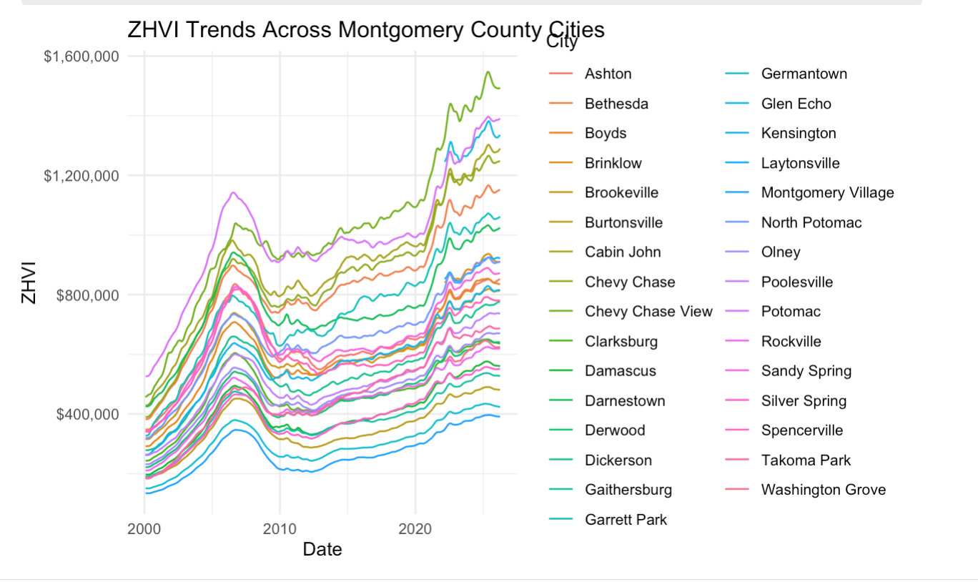
Exploratory Data Analysis
Housing prices increased substantially over time
Appreciation varied across cities
Some markets showed stronger acceleration

Slide 7
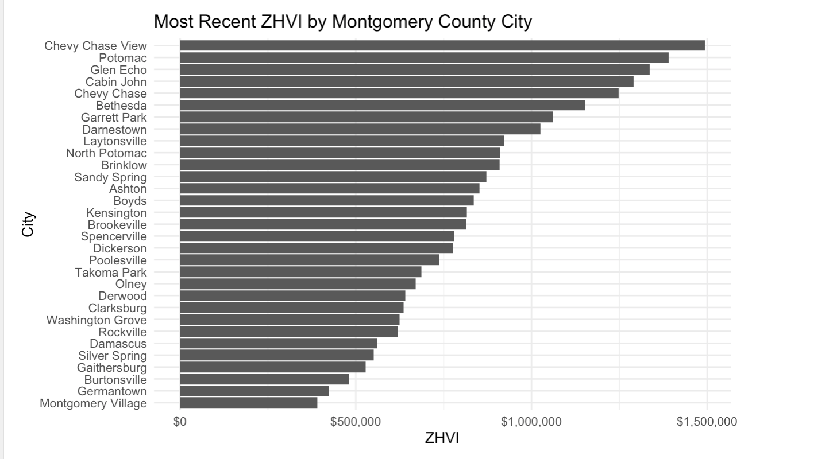
EDA Continued

Slide 8
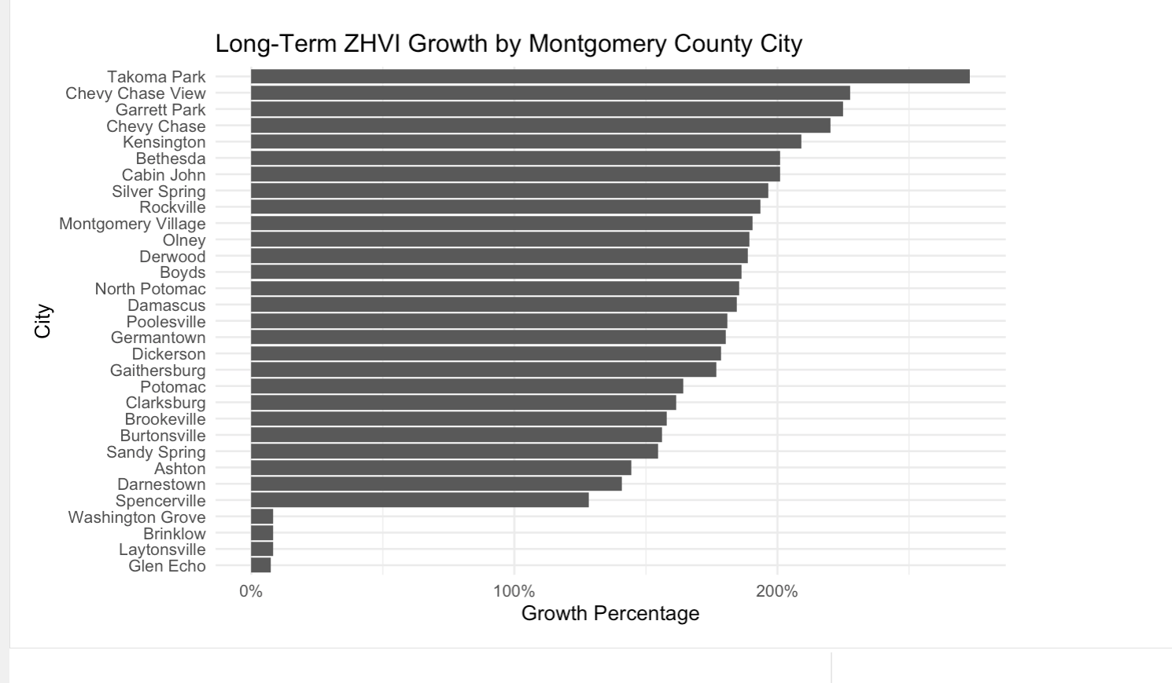
Long Term Growth Analysis
Certain cities experienced stronger appreciation
Growth varied significantly across the county
Long-term growth became a core investment metric

Slide 9
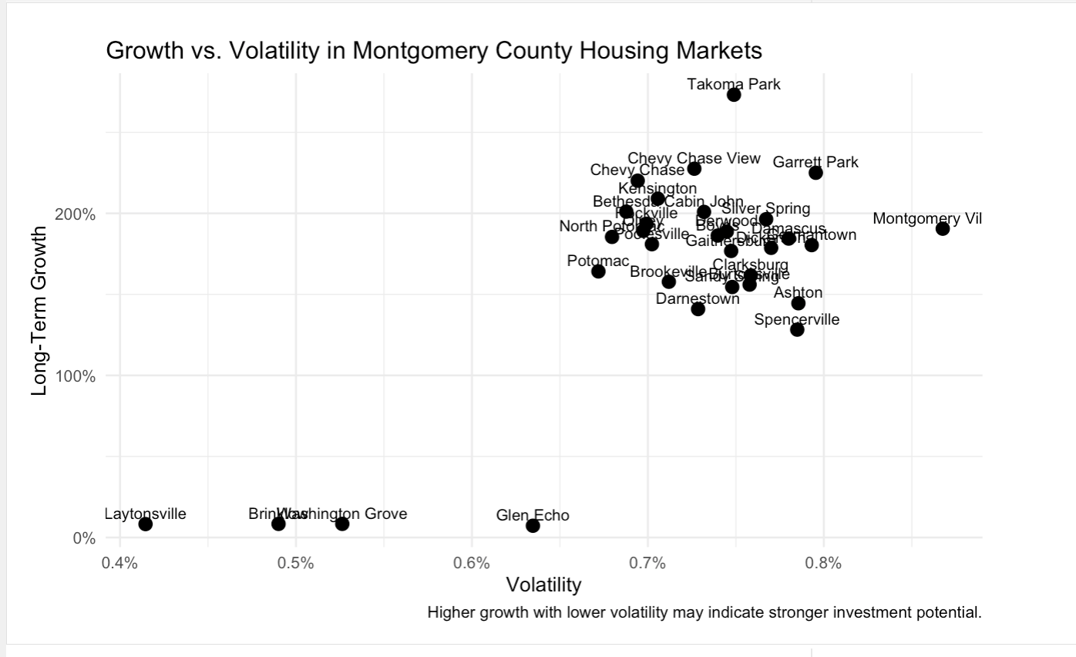
VOLATILITY & RISK ANALYSIS
Higher growth can involve higher risk
Volatility measures market stability
Some cities balanced growth and stability better

Slide 10
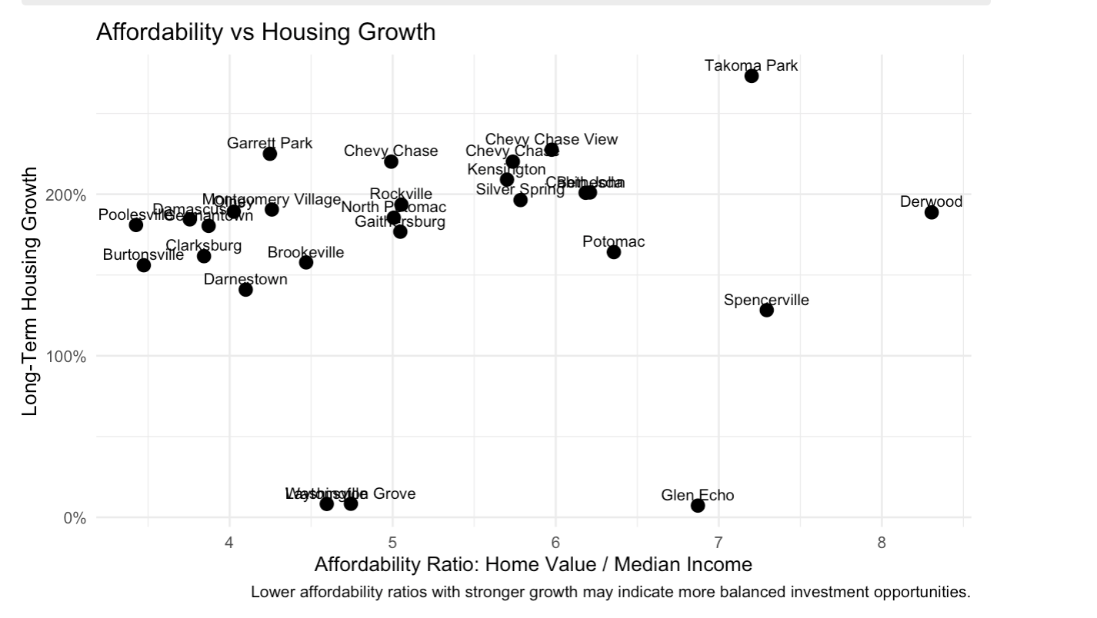
DEMOGRAPHIC & AFFORDABILITY ANALYSIS
Compared housing prices relative to income
Population and income influence housing demand
Affordability pressures differed between cities

Slide 11
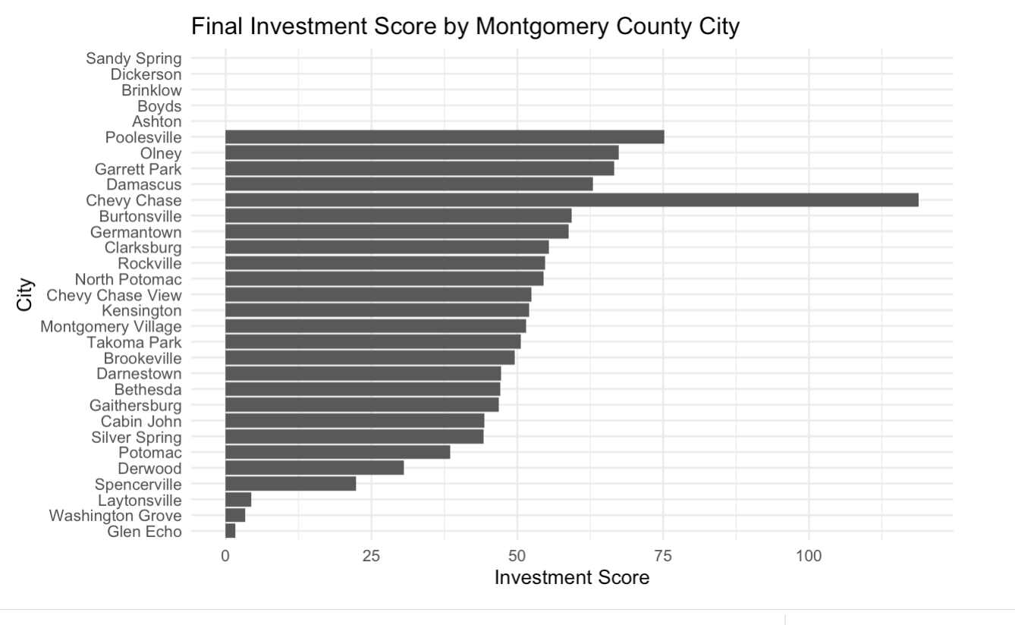
FINAL INVESTMENT SCORE
Goal: Develop a more balanced way to evaluate long-term residential investment potential.
Long-Term Growth
Measures total housing appreciation over time
Higher growth may indicate stronger returns
Volatility
Measures fluctuations in monthly housing price changes
Lower volatility may indicate more stable markets
Affordability Ratio
Compared housing prices relative to local median income
Lower ratios indicate stronger affordability support

Slide 12
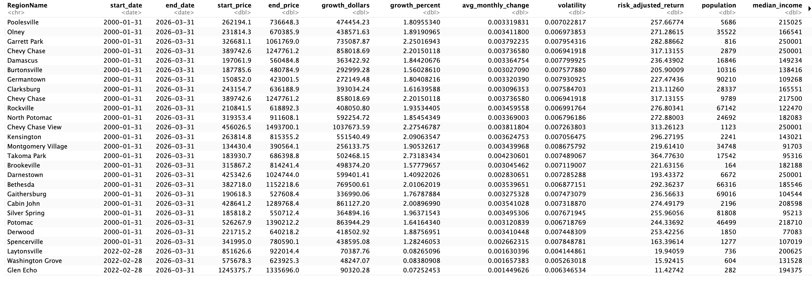
Investment Score

Slide 13
Key Findings & Investment Insights
Housing prices grew very differently across Montgomery County cities
Some cities showed strong long-term growth while remaining more stable over time
Expensive housing markets were not always the strongest investment opportunities
Smaller cities sometimes ranked highly due to balanced growth and affordability
Combining multiple factors created a more complete investment analysis
Chevy Chase ranked among the strongest overall investment markets
Takoma Park experienced some of the fastest long-term appreciation
Bethesda and North Potomac showed strong growth supported by high income levels
Some lower-ranked cities had weaker appreciation trends or limited historical data
Population and income trends appeared to support stronger housing demand in top-performing areas

Slide 14
LIMITATIONS & FUTURE IMPROVEMENTS
Limitations
Zillow values are estimates
Census data uses survey estimates
Some geographic matching limitations
Future Improvements
Interest rates
Property taxes
School quality
Rental vacancy rates
Cap rates

Slide 15
Conclusion
This project combined housing and demographic data to evaluate long-term residential investment potential across Montgomery County.

Slide 16
Questions?

Slide 17
Acknowledgements
Professor Lori Perine
Data Science Department – Professor Saidi & Alraee
Robby Manihani – Stanford Research Labs

Slide 18
Sources
Zillow Research — Zillow Home Value Index (ZHVI)
https://www.zillow.com/research/data/
United States Census Bureau — American Community Survey (ACS)
https://www.census.gov/programs-surveys/acs
tidycensus Documentation
https://walker-data.com/tidycensus/

